Slide 1
Lecture 28-30
Transactions

Slide 2
Transaction
A transaction is a unit of program execution that accesses and possibly updates various data items.

Slide 3
ACID Properties
Database system maintain the following properties of the transactions:
Atomicity: Either all operations of the transaction are reflected properly in the database, or none are.
Consistency: If the database was in a consistent state before the execution of a transaction, it must remain consistent after the execution of the transaction as well.
Isolation: Multiple transactions occur independently without interference.
Durability: After a transaction completes successfully, the changes it has made to the database persist, even if there are system failures.

Slide 4
Transactions access data using two operations:
read(X), which transfers the data item X from the database to a variable, also called X, in a buffer in main memory belonging to the transaction that executed the read operation.
write(X), which transfers the value in the variable X in the main-memory buffer of the transaction that executed the write to the data item X in the database.

Slide 5
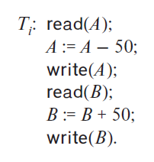
Let Ti be a transaction that transfers $50 from account A to account B. This transaction
can be defined as:

Slide 6
Transaction atomicity & durability
Aborted Transaction:
When a transaction may not complete its execution successfully that is called an aborted transaction.
Rolled back Transaction:
Once the changes caused by an aborted transaction have been undone, we say that transaction is rolled back transaction.
Log:
By maintaining Log we can manage aborted transactions.
Record the identifier of the transaction.
Record old & new value.

Slide 7
Transaction atomicity & durability
Maintaining a log provides the possibility of redoing a modification to ensure Atomicity & Durability.
Also the possibility of undoing a modification to ensure atomicity in case of a failure during transaction execution.
Committed Transaction:
A transaction that completes its execution successfully is said to be committed.
Once a transaction has committed, we cannot undo its effects by aborting it.
Undo can be possible to execute a compensating transaction.

Slide 8
successful completion of a transaction
A transaction must be in one of the following states:
Active, the initial state; the transaction stays in this state while it is executing.
Partially committed, after the final statement has been executed.
Failed, after the discovery that normal execution can no longer proceed.
Aborted, after the transaction has been rolled back and the database has been restored to its state prior to the start of the transaction.
Committed, after successful completion.

Slide 9
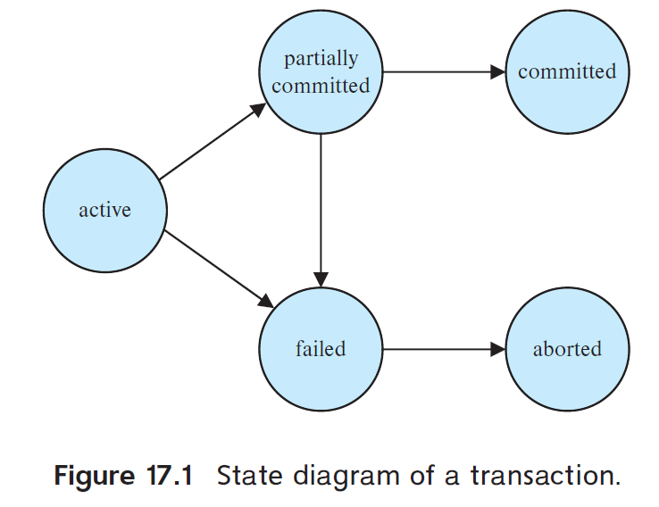

Slide 10
States of transaction
A transaction enters the failed state (due to hardware or logical errors) must be rolled back. Then it enters the aborted state.
Here system has 2 options:
Restart the transaction, if the transaction was aborted as a result of some hardware or software error. A restarted transaction is considered to be a new transaction.
Kill the transaction. It usually does so because of some internal logical error or because the bad input, or because the desired data were not found in the database.
Observable external writes : We must be cautious when dealing with observable external writes, such as writes to a user’s screen, or sending email, dispensing cash.

Slide 11
Transaction isolation
Multiple transactions to run concurrently causes several complications with consistency of the data.
Concurrent execution of transactions requires extra work.
It is easier if transactions run serially.

Slide 12
2 reasons for allowing concurrency
Improved throughput and resource utilization
Reduced waiting time: It reduces the average response time

Slide 13
When several transactions run concurrently, the isolation property may be violated,
resulting in database consistency being destroyed despite the correctness of each
individual transaction.

Slide 14
Concurrent access anomaly
Account with balance $10000
Two clerks A & B
A clerk debit $500 ➔ 10000 – 500 = $9500
B clerk debit $100 ➔ 10000 – 100 = $9900
Correct value is $9400

Slide 15
concurrency-control schemes
It is a control mechanism that the interaction among the concurrent transactions to prevent them from destroying the consistency of the database

Slide 16
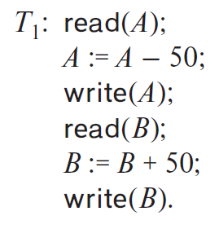
Let T1 and T2 be two transactions that transfer funds from one account to another. Transaction T1 transfers $50 from account A to account B. It is defined as:

Slide 17
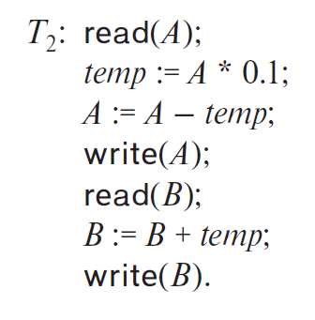
Transaction T2 transfers 10 percent of the balance from account A to account B. It is
defined as:

Slide 18
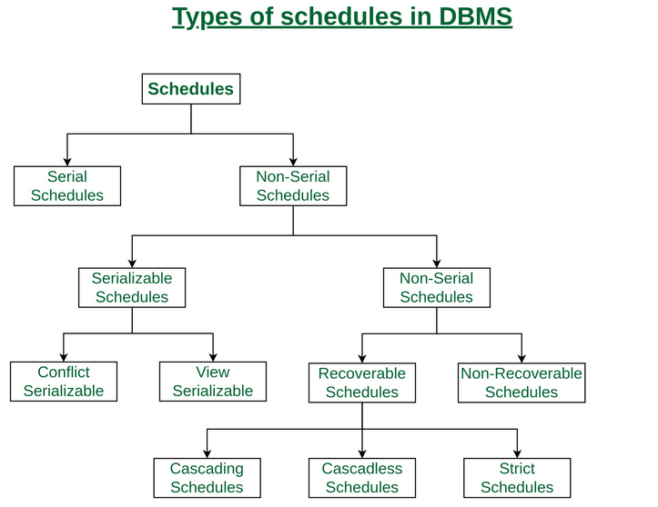
Schedules
The execution sequences are called Schedules.

Slide 19
Types of schedules
Serial Schedules: a serial schedule is one in which no transaction starts until a running transaction has ended are called serial schedules.

Slide 20
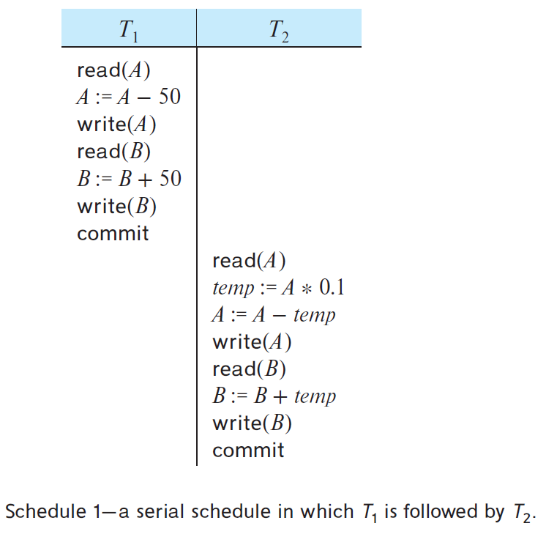
Serial Schedules

Slide 21
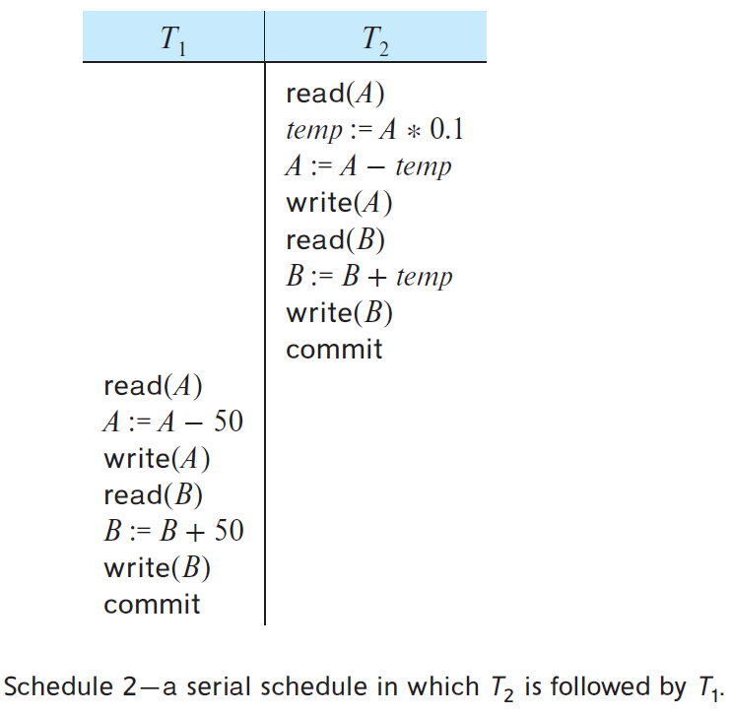
Serial Schedules
These schedules are serial.

Slide 22
For a set of n transactions, there exist n factorial (n!) different valid serial schedules.

Slide 23
Types of schedules
Non-Serial Schedule: in the non-serial schedule, the other transaction proceeds without waiting for the previous transaction to complete.
Non-Serial Schedule can be divided further into:
Serializable: The non-serial schedule is said to be in a serializable schedule only when it is equivalent to the serial schedules, for an n number of transactions. A serializable schedule is the one that always leaves the database in consistent state. Two types:
Conflict Serializable
View Serializable
Non-Serializable: Divided into two types:
Recoverable
Non Recoverable

Slide 24
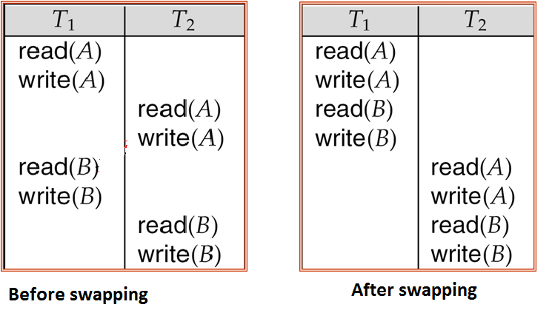
Serializable
Conflict Serializable: A schedule is called conflict serializable if it can be transformed into a serial schedule by swapping non-conflicting operations. Two operations are said to be conflicting if all conditions satisfy:
They belong to different transactions
They operate on the same data item
At Least one of them is a write operation

Slide 25
Whether a Schedule is Conflict Serializable Or Not?
Step-01:
Find and list all the conflicting operations.
Step-02:
Start creating a precedence graph by drawing one node for each transaction.

Slide 26
Whether a Schedule is Conflict Serializable Or Not?
Step-03:
Draw an edge for each conflict pair such that if Xi (V) and Yj (V) forms a conflict pair then draw an edge from Ti to Tj.
This ensures that Ti gets executed before Tj.
Step-04:
Check if there is any cycle formed in the graph.
If there is no cycle found, then the schedule is conflict serializable otherwise not.

Slide 27
Problem#1
Check whether the given schedule S is conflict serializable or not-
S : R1(A) , R2(A) , R1(B) , R2(B) , R3(B) , W1(A) , W2(B)
T1 | T2 | T3
R(A)
 | R(A)
R(B)
 | R(B)
 |  | R(B)
W(A)
 | W(B)

Slide 28
Step#1
List all the conflicting operations and determine the dependency between the transactions-
R2(A) , W1(A) (T2 → T1)
R1(B) , W2(B) (T1 → T2)
R3(B) , W2(B) (T3 → T2)

Slide 29
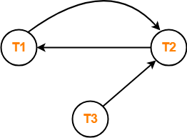
Step#2
Draw the precedence graph
Clearly, there exists a cycle in the precedence graph.
Therefore, the given schedule S is not conflict serializable.

Slide 30
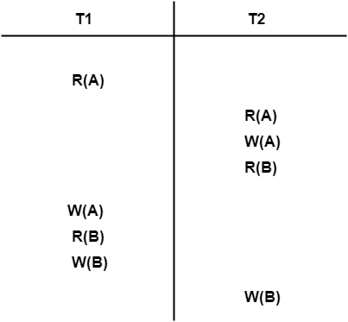
Problem#2

Slide 31
Step#1
List all the conflicting operations
R1(A) , W2(A) (T1 → T2)
R2(A) , W1(A) (T2 → T1)
W2(A) , W1(A) (T2 → T1)
R2(B) , W1(B) (T2 → T1)
R1(B) , W2(B) (T1 → T2)
W1(B) , W2(B) (T1 → T2)

Slide 32
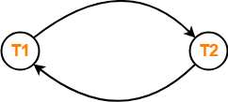
Step#2
Draw a graph
Clearly, there exists a cycle in the precedence graph.
Therefore, the given schedule S is not conflict serializable.
Thus, Number of possible serialized schedules = 0.

Slide 33
Task
T1 | T2 | T3
R(x)
 |  | R(y)
 |  | R(x)
 | R(y)
 | R(z)
 |  | W(y)
 | W(z)
R(z)
W(x)
W(z)
Check whether the given schedule is conflict serializable or not? If yes then draw equivalent schedule

Slide 34
Serializable
View Serializable: A Schedule is called view serializable if it is view equal to a serial schedule. A conflict schedule is a view serializable but if the serializability contains blind writes, then the view serializable does not conflict serializable.

Slide 35
Inconsistent
Consistent
View Schedule
Conflict Schedule

Slide 36
Suggested Reading
Chapter 22 of Database Systems: A Practical Approach to Design, Implementation, and Management by Thomas Conolly 6th Edition
Chapter 14 of Database System Concepts by Abraham Silberschatz

Slide 37
References
https://www.db-book.com/db6/slide-dir/index.html
https://www.pearson.com/us/higher-education/product/Connolly-Powerpoint-Slides-for-Database-Systems
https://www.gatevidyalay.com/equivalence-of-schedules-equivalent-schedules-in-dbms/

